Slide 1
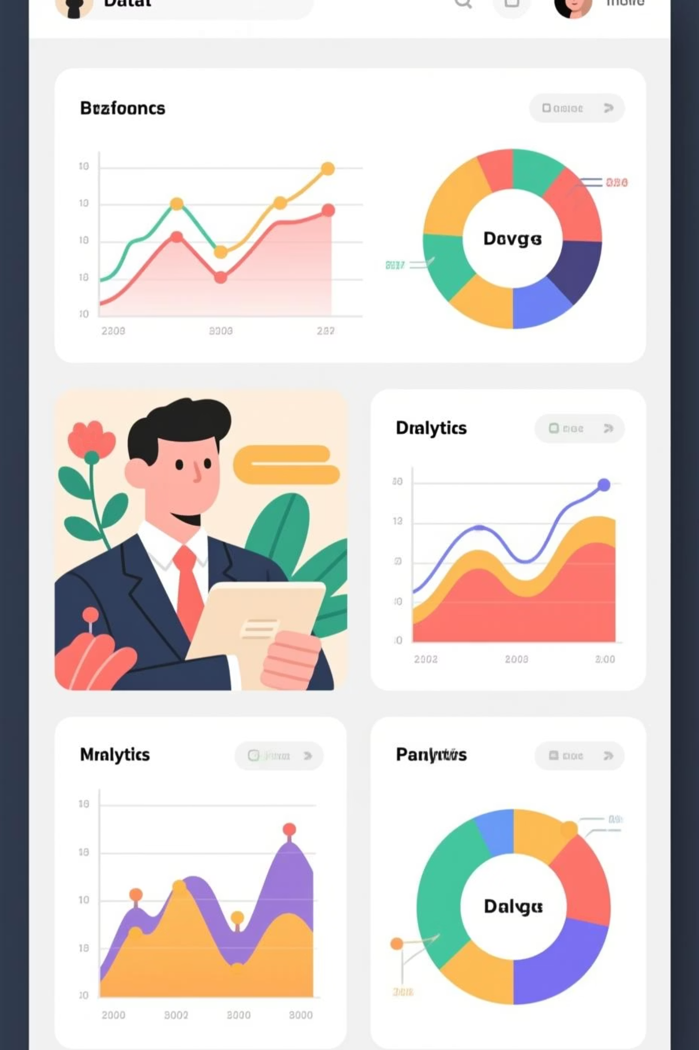
Data Analysis Report: Ola
Project Tools Used: Python, SQL (MySQL), Power BI, Excel

Slide 2
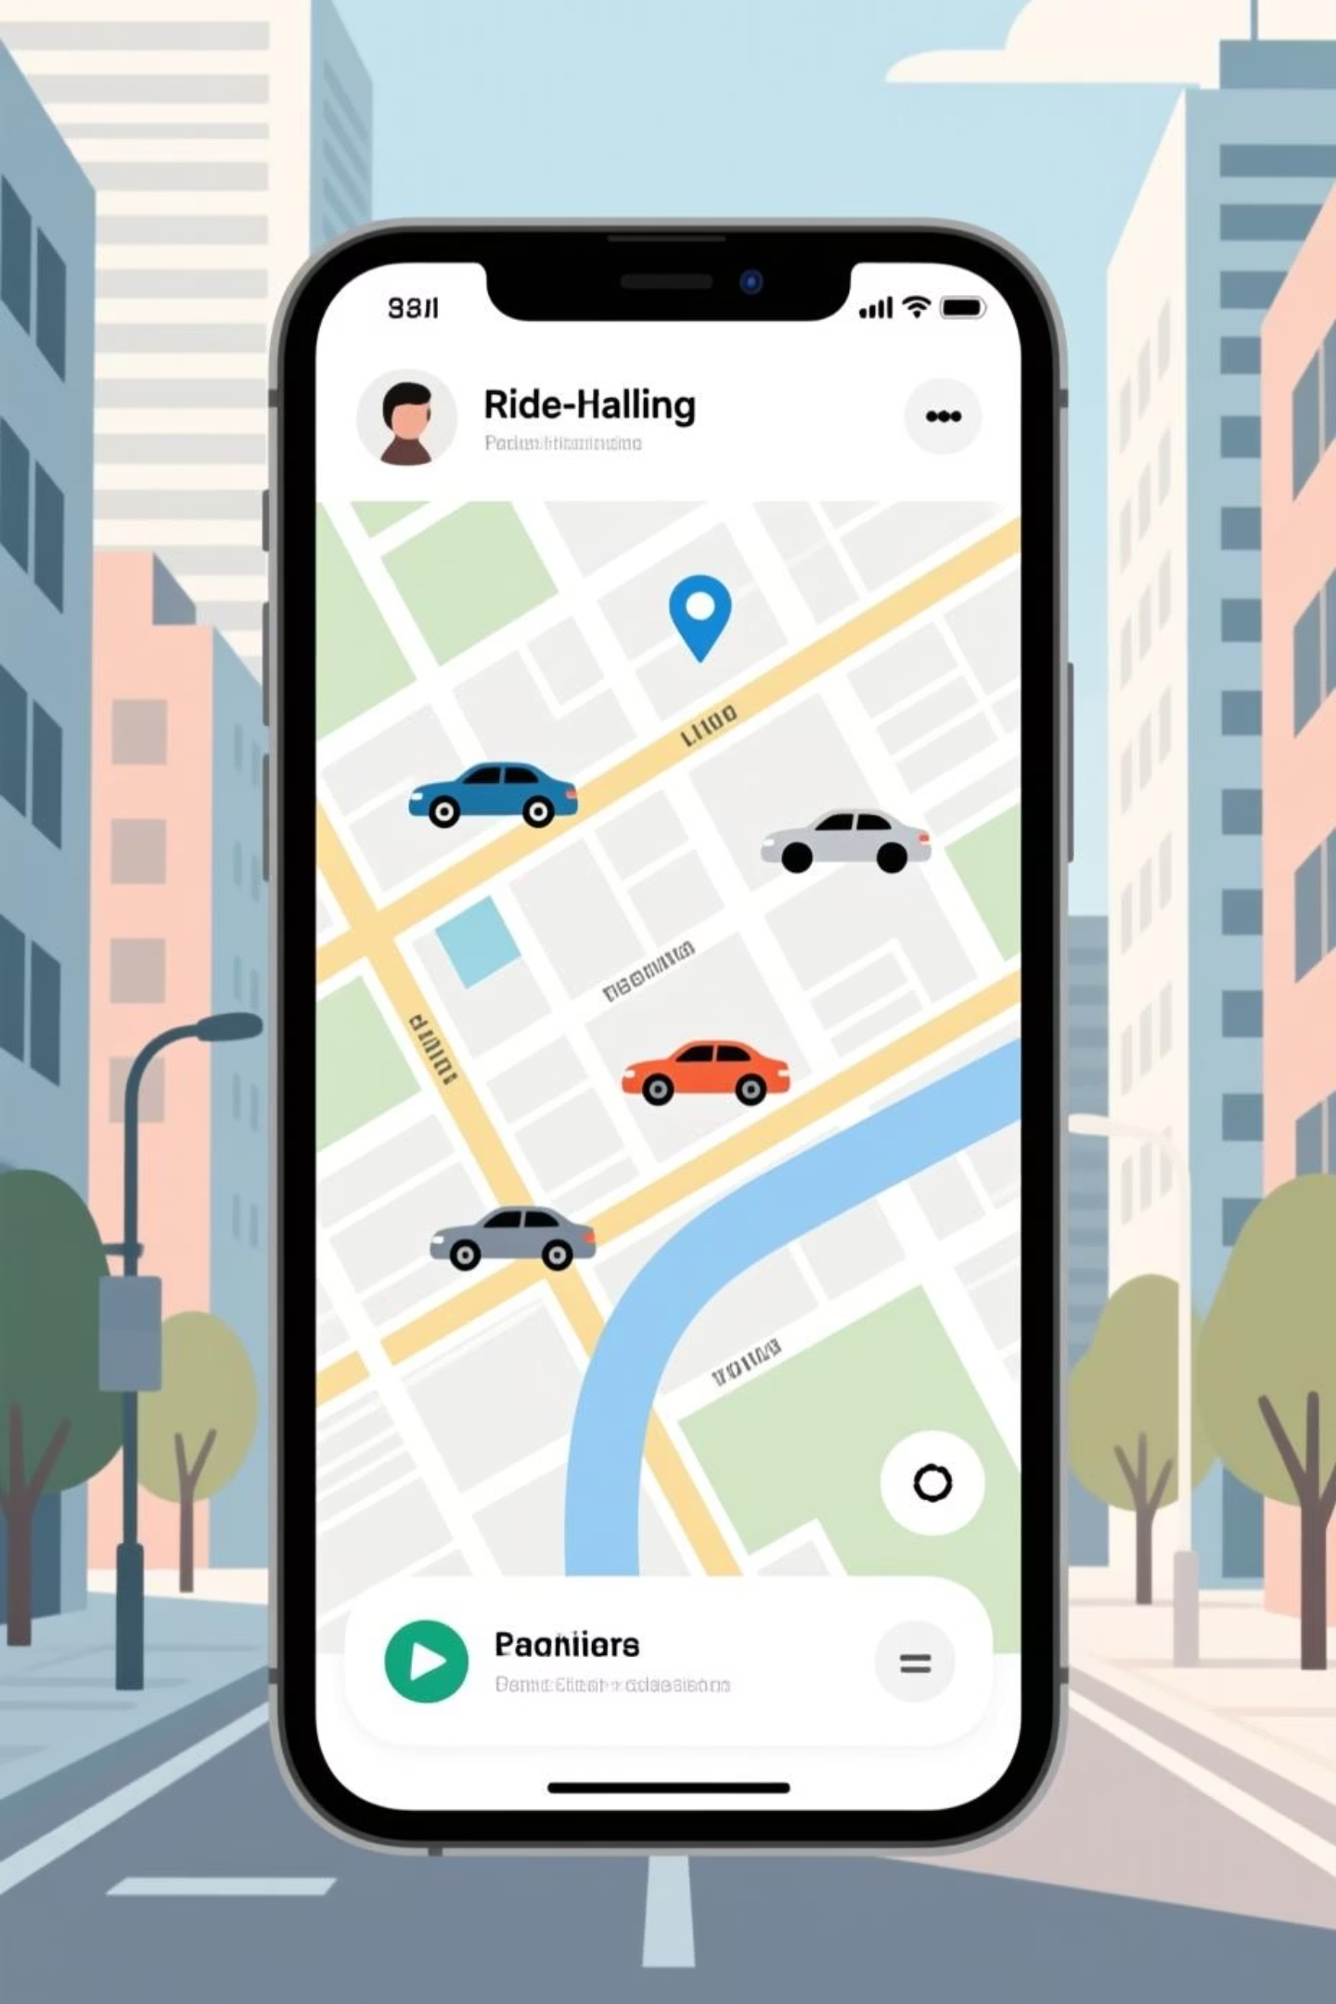

Project Objective
Cancellation Drivers
Identify key factors behind high cancellation rates
Booking Trends
Understand patterns and vehicle performance
Operational Gaps
Pinpoint bottlenecks like "Driver Not Found"
Revenue Optimization
Evaluate ratings, revenue, payment preferences

Slide 3
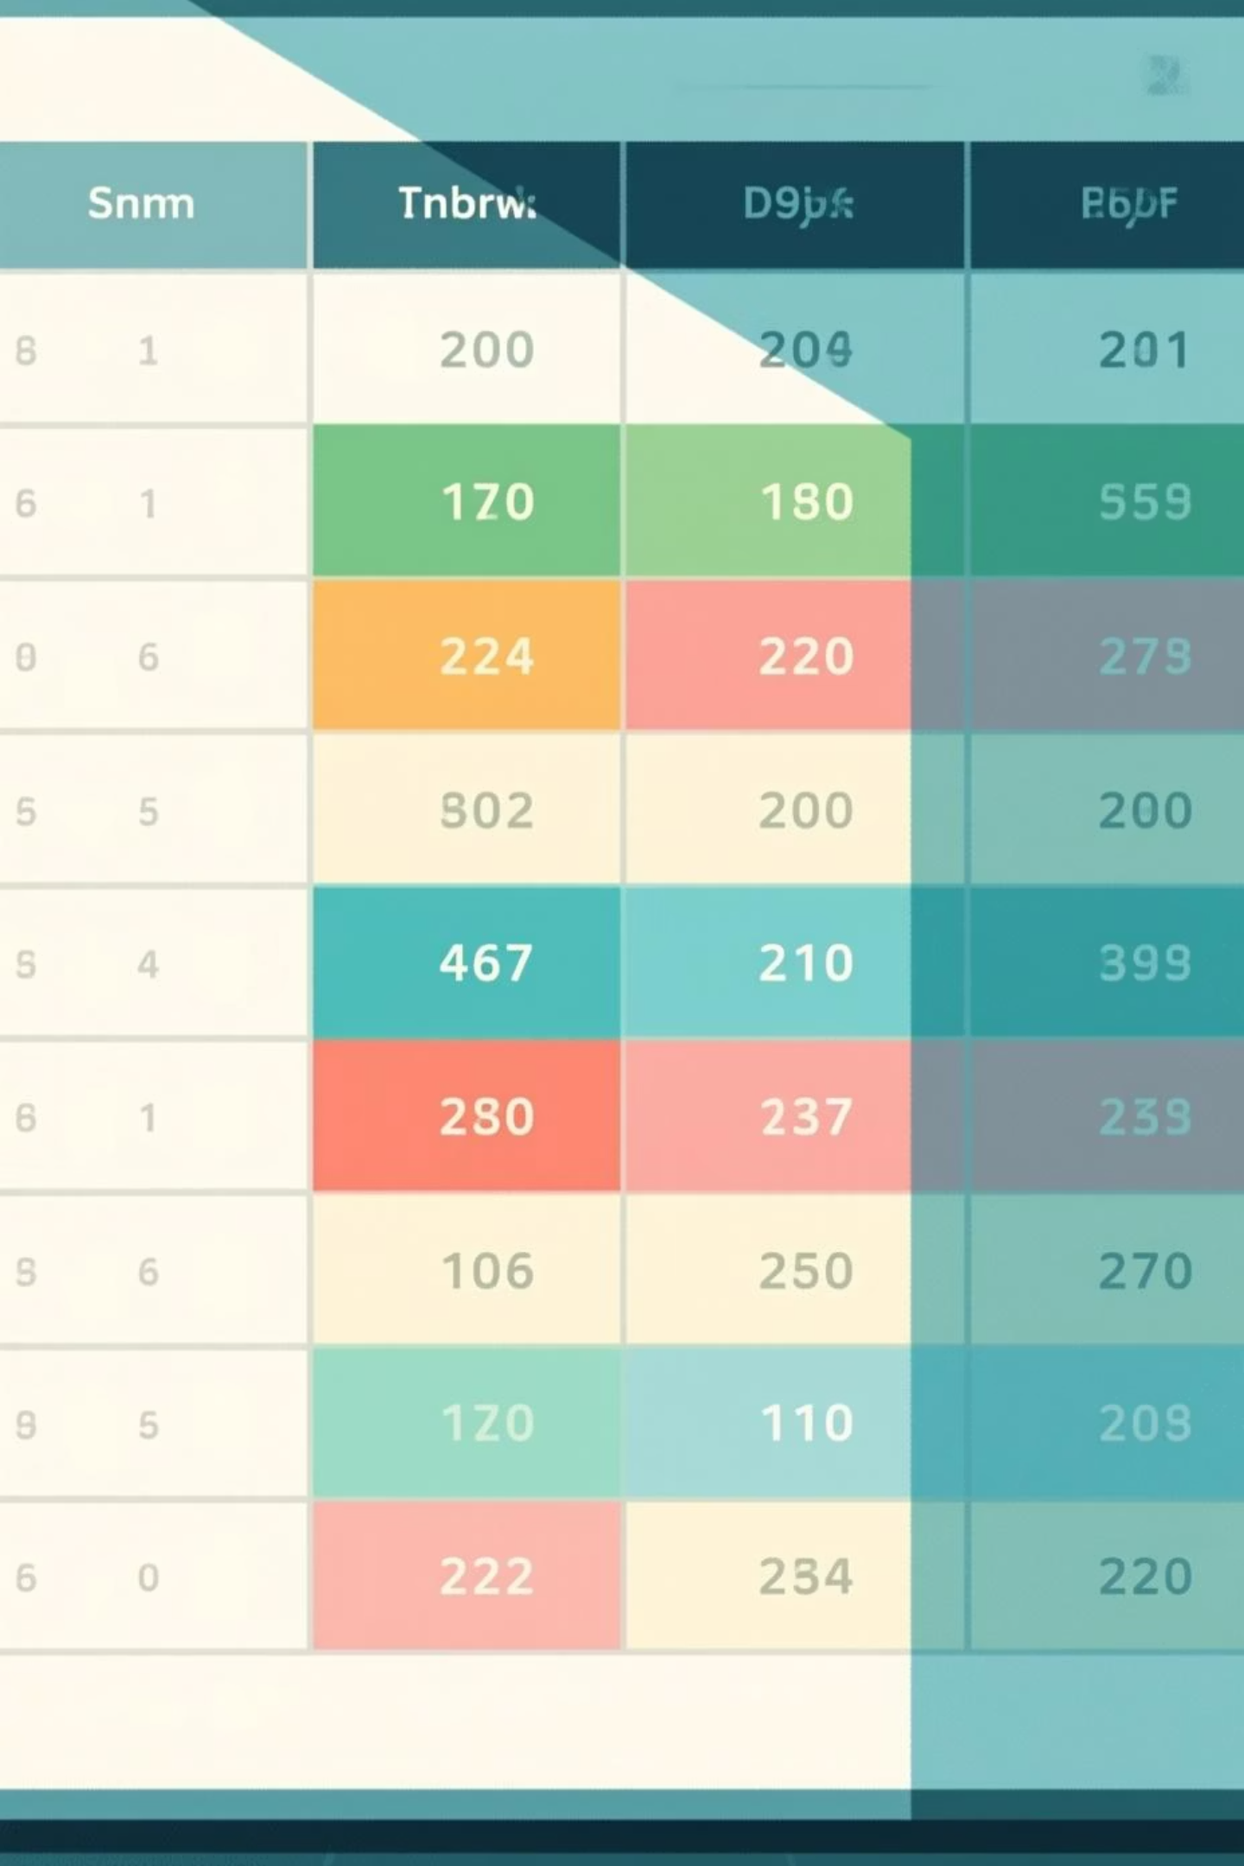
Dataset Overview
Dataset Size
Unique Counts
Total records: 103,024
Booking Status: 4
Columns: 21
Vehicle Types: 7
Memory: 16.5 MB
Locations: 50 each
Key Variables
Payment Methods: 4
Ratings: 21 unique values
Booking details: Date, Time, Status
Missing Data
Customer & Driver ratings
Significant gaps in TAT, ratings, cancellation reasons—handled through cleaning
Ride details: Vehicle Type, Distance
Financials: Value, Payment Method

Slide 4

Data Cleaning & Preprocessing
Performed using Python (Pandas) and Power BI
01
Remove & Validate
Removed blank columns, checked nulls, validated Booking_ID uniqueness
02
Standardize Formats
Cleaned date/time formats, trimmed text, normalized categories
03
Convert & Transform
Converted datatypes, removed spaces, ensured consistency
04
Quality Assurance
Validated for accurate visualizations and SQL queries

Slide 5
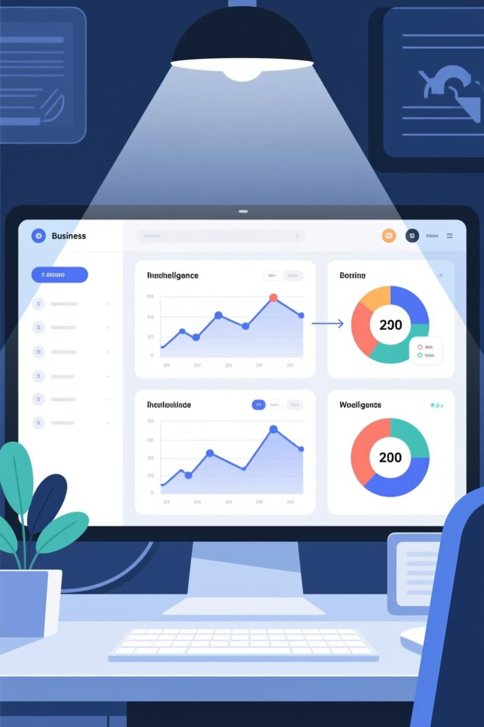



Methodology
Python (EDA)
Imported dataset, reviewed structure, evaluated missing data, performed transformations
SQL (Deep-Dive)
Analyzed successful bookings, ride distance, customer patterns, cancellations, revenue
Power BI (Visualization)
Created interactive dashboards with line charts, donut charts, tables, DAX measures
Multi-tool approach ensured complete 360° system understanding

Slide 6

Key Insights

Slide 7
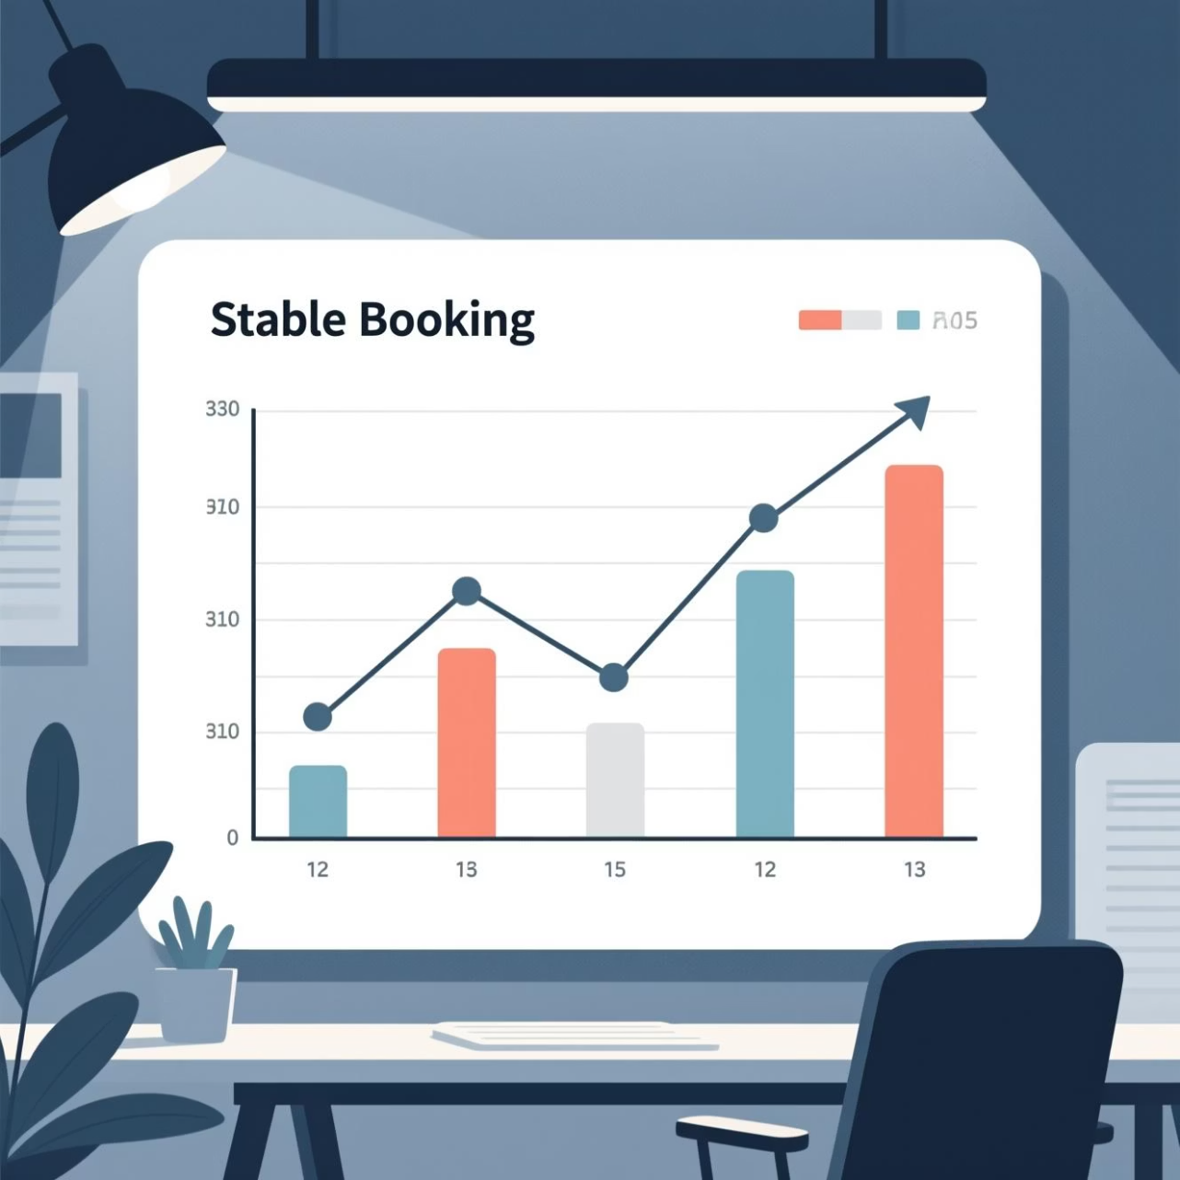

Booking Trends
Daily bookings remained stable between 3200–3400 during July
3432
3072
Highest
Lowest
July 30
July 31
Consistent, predictable demand without major volatility

Slide 8

Booking Status Performance
103K
64K
29K
Total Bookings
Successful
Cancelled
28%
Cancellation Rate
Industry benchmark target: <10%
Driver Cancellations
Driver Not Found
18K (highest category)
10K → Supply-demand imbalance

Slide 9

Vehicle Type Performance
Prime Sedan
Highest total booking value
Highest successful trip value
Highest total distance traveled
E-Bike
Highest average ride distance
Prime Plus
Highest customer rating

Slide 10

Payment Method Insights
Cash
UPI
Dominant payment mode—largest share of revenue
Primary digital payment method
Cards
Minimal adoption → low digital penetration

